Slide 1
Digital Factory Operating System
Mind Benders
Nov 2018

Slide 2
Agenda
1
Business Context
2
Problem Statement
3
Demo
4
Features and Benefits
5
Business Quantification
6
Q&A

Slide 3
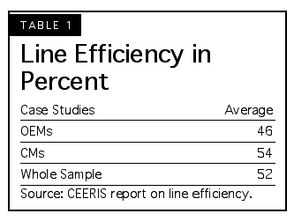
Business Context
Digital Factory Operating system is working on factory governance and establishes standard guidelines for action taken with right KPI management
Assembly line process
Objectives of Lean is to achieve smooth continuous flow of material through the process. If there is any flaw, cause inventories and prevent through put from matching customer demand
Worker used to work at one- or two-person work stations and perform repetitive tasks, now teams of workers can follow a job down the assembly line
Efficiency Assembly line methods were introduced to increase factory productivity and efficiency.
LINK
Notes:
Unskilled labour refer to workers in the elementary occupation as defined by the Census and Statistics Department.

Slide 4
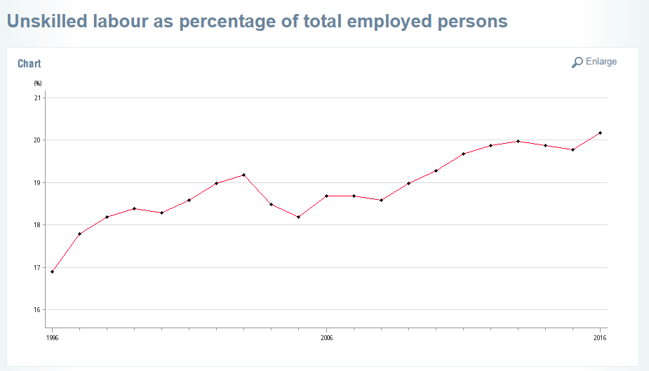
Problem Statements
?
1
Employee skill deficiency on machine Operations
2
Unavailability of tracking efficiency of machine
Notes:
Unskilled labour refer to workers in the elementary occupation as defined by the Census and Statistics Department.

Slide 5
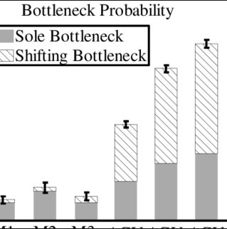
Problem Statements
?
3
Problem in tracking the efficiency of every stage
4
Difficult in identifying hindering manufacturing process
Notes:
https://www.google.co.in/url?sa=i&source=images&cd=&cad=rja&uact=8&ved=2ahUKEwirjbnZuPbeAhUQiHAKHfIQA4AQjhx6BAgBEAM&url=https%3A%2F%2Fwww.researchgate.net%2Fpublication%2F4053602_Comparison_of_bottleneck_detection_methods_for_AGV_systems&psig=AOvVaw1Lhee8SrMFqyjYsC5sYX8h&ust=1543472154346025

Slide 6

Solution
Let’s create our OWN Assembly trend using
Augmented Reality, IOT , Block Chain and 3D Scanning

Slide 7


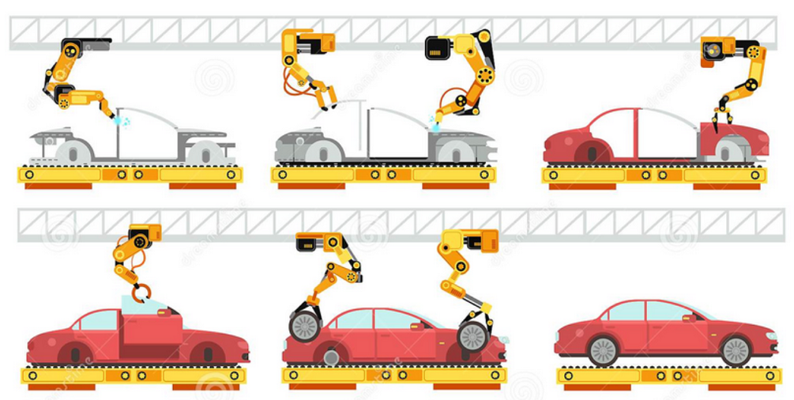
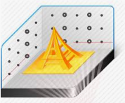



Solution Approach
Operator
Mobile App
3D Scanning
Operator
Operator
Analytics
IOT

Slide 8
Features
OLE/OEE
Idle Time
Efficiency
Overall effectiveness day and week with target is achieved using ML for every machines
Machine’s idle time is captured to get identify efficiency of Line
Each sub stage efficiency is calculated
Productivity
3D
Worker
Efficiency
OLE/OEE
IdleTime
Productivity
3D Scanning
Worker
Complete Analysis of total with ideal productivity
Identifying bottleneck machines
Capturing the physical measurements of any physical object.
Saving time in design work
Worker productivity based on their shifts and idle time is identified

Slide 9
Benefits
1
Capturing the productivity of worker and efficiency of lines
2
End to End live Asset Productivity tracking with minimal auditing cost
3
Digital way of guidance to worker using Augmented Reality
4
Reliable update from substation using IOT Sensors
5
Learning of optimal running parameters and predicting the future efficiency
Utilizing in modern manufacturing on parts that were originally manufactured before CAD
6

Slide 10
Business Quantification
OEE
24 % Citing OEE Improvement can be achieved
10%
Product Line
15%
10% improvement in line throughput
24%
Worker
12 points increase in labor utilization
12
Productivity
15% productivity improves on identifying manufacturing defects

Slide 11
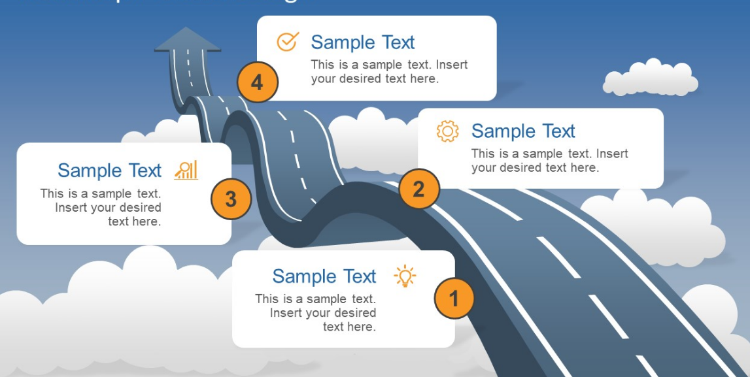
Road Map
For
Employee Safety using Smart watches
Applying mechanism for fully automated lines
Visualization of asset conditions using smart glasses
Extracting data from PLC/Scada Controller

Slide 12
Q & A

